Slide 1
DevHack
2020

Slide 2
Team Triple_5
001₂
Anubhab Hota
Team Captain , Backend Developer
010₂
Prabhav Tewari
Frontend Developer , Creative UI Designser
011₂
Aryan Raj Banerjee
Backend Developer
Theme Domain : Environment
DevHack 2020 DSCKIIT

Slide 3
PROBLEM STATEMENT
Design a smart waste collection system that allows citizens to segregate the various types of solid waste they want to dispose and the municipal authorities to efficiently collect the same.
Over 377 million urban people live in 7,935 towns and cities and generate 62 million tonnes of municipal solid waste per annum in India as per survey by IIT Kanpur in 2006 & 2019.
Most recyclable waste ends up in a dump yard due to the lack of efficient waste management.
Solid Waste Management (SWM) is one among the basic essential services provided by municipal authorities to keep urban centres clean. However flawed system of waste disposal is in practice of dumping waste within or outside the urban areas hapazardly.

Slide 4
SOLUTION
CREATION OF A WEB PORTAL 'TrashEx' KEEPING TRACK OF WASTE
We envisioned this website that would collect the data on each waste pickup and optimize the process through use of several APIs that make the process userfriendly and easier for both citizens as well as municipal authorities.
EASY COMMUNICATION BETWEEN CONCERNED USERS
DATABASE FOR MANAGING THE WASTE COLLECTED
SEPARATE COLLECTION OF RECYCLABLE WASTE
ROUTE AND LOCATION OPTIMIZATION WHILE COLLECTION

Slide 5

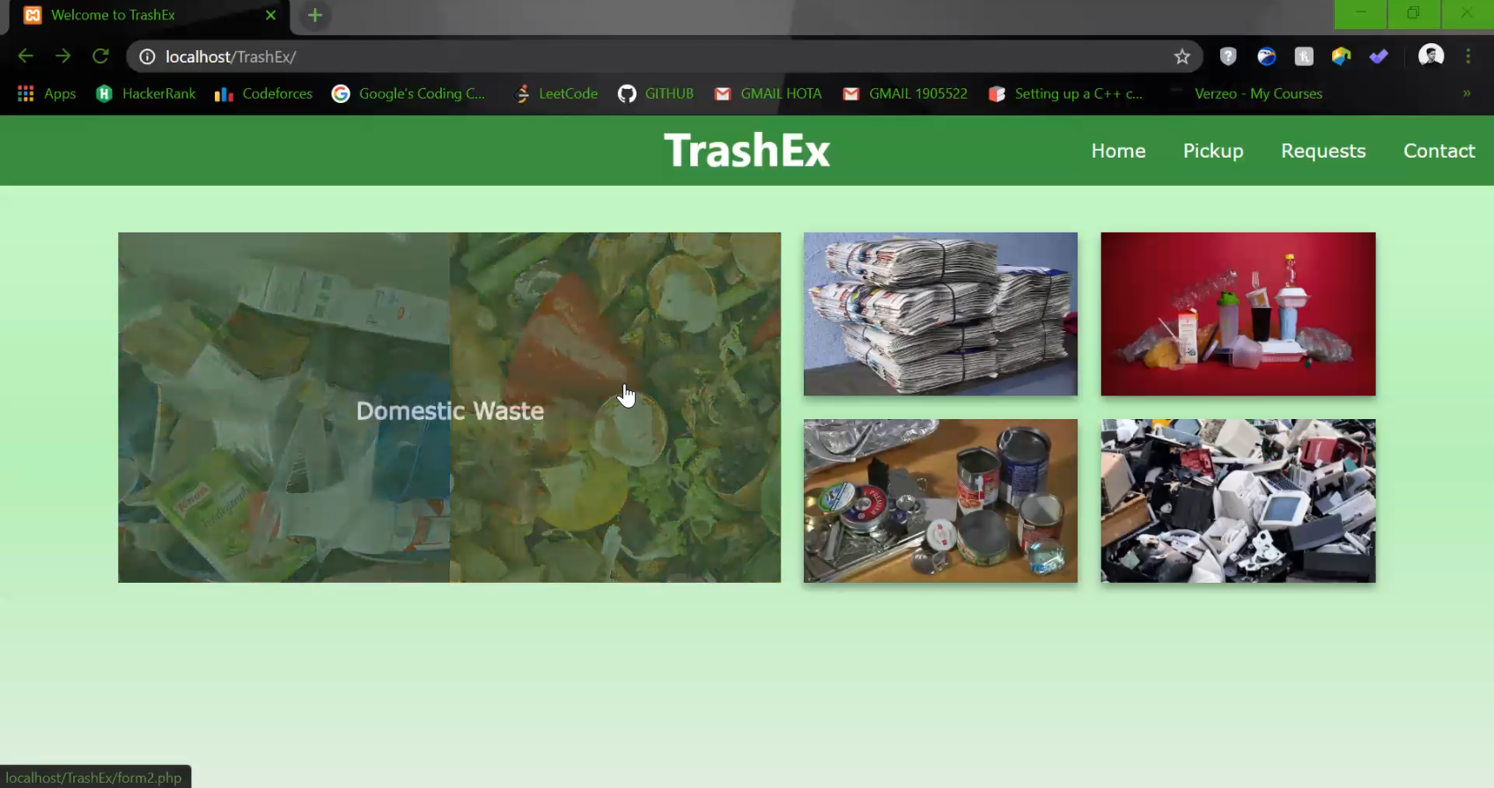
FEATURES OF OUR WEBSITE
A separate provision for collection of domestic and recyclable waste.
Sell requests genration with location of recyclable material
in database that can be viewed by Municipalities and Waste Management , or Recycling Firms.
Storing Location Data and using it to optimize routes by APIs for better deploying of Garbage Pickup Resources.

Slide 6
HOW IT HELPS
1. This project is beneficial to both citizens as users and also the municipalities and other agencies.
It provides them encouragement to separate the waste at source to their own benefit of selling it for a price with such user-friendly portal.Thus promotes wate segregation.
2. The Municipalities can now keep a track of different types of waste coming in , because as per currrent reports only 29% of the waste is recycled of the 44+ million tonnes of waste collected from urban areas.
3. The recycling industry benefits from having a direct connection with the potential sell of junk.

Slide 7
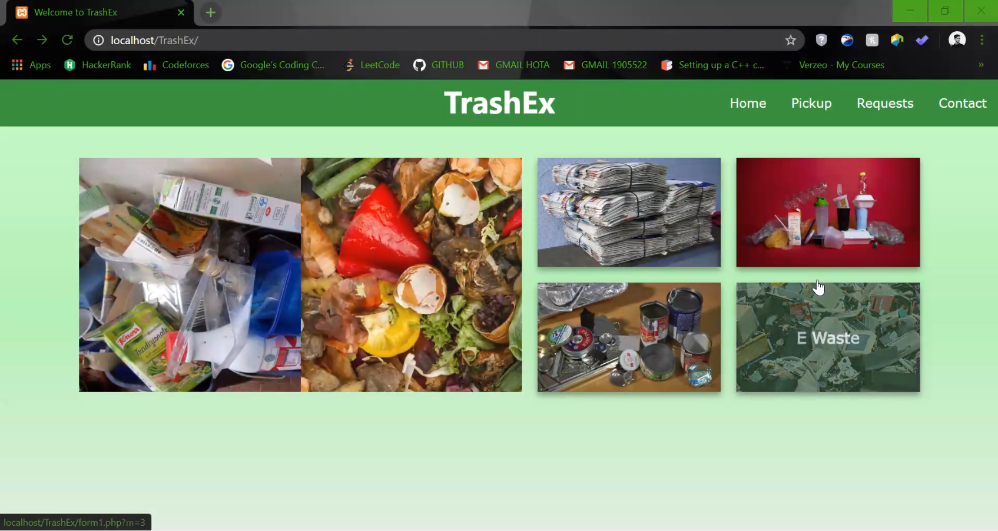
SELECTING TYPE OF WASTE IN THE WEBSITE
The User can choose what kind of waste he wants to be picked up. The basic kinds included are domestic & recyclable (papers,plastic,metal ,E-waste) and there's a provision to generate sell requests for recyclable materials.

Slide 8
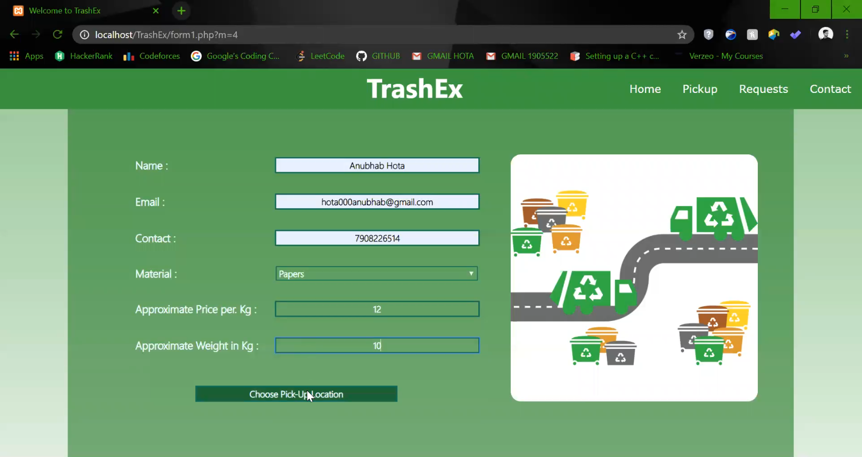
REQUEST FORM FILLING
A simple interface for just domestic waste pickup and also a suto genrated form for selecting requests for recyclable maetrial sell.The User is then redirected to the location choosing on Google Maps using its JavaScript API.

Slide 9
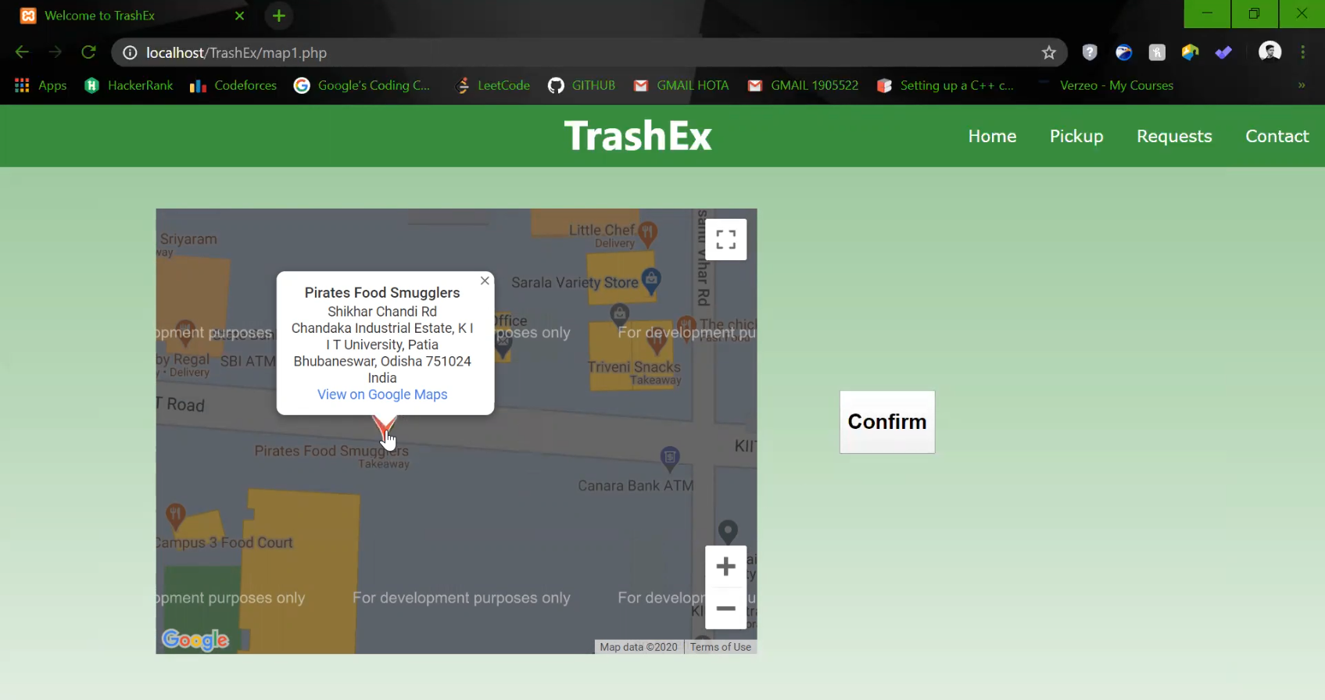
GOOGLE MAPS FOR RETRIEVING LOCATION DATA
An Integrated Google Map in the UI to get exact pickup location of the waste.

Slide 10
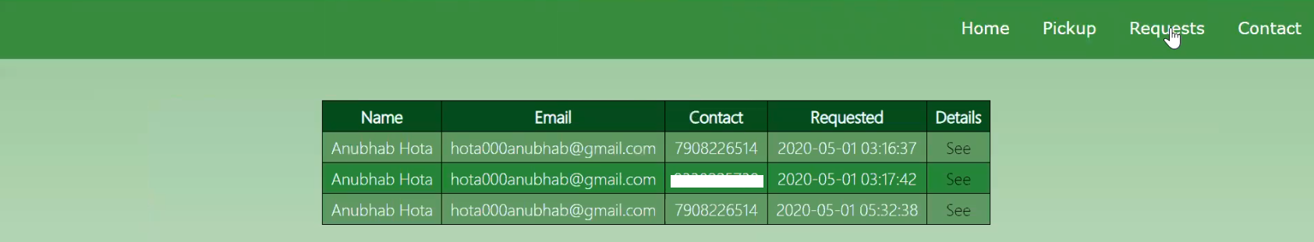
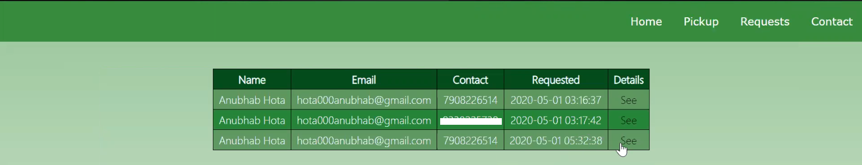
REQUEST PAGE FOR RECYCLABLE MATERIALS
This Data is rendered from the Data and can be viewed by Municipalities and agencies to track the waste and check details.A similar page is also there for domestic waste pickup. On clicking further details can be viewed.

Slide 11
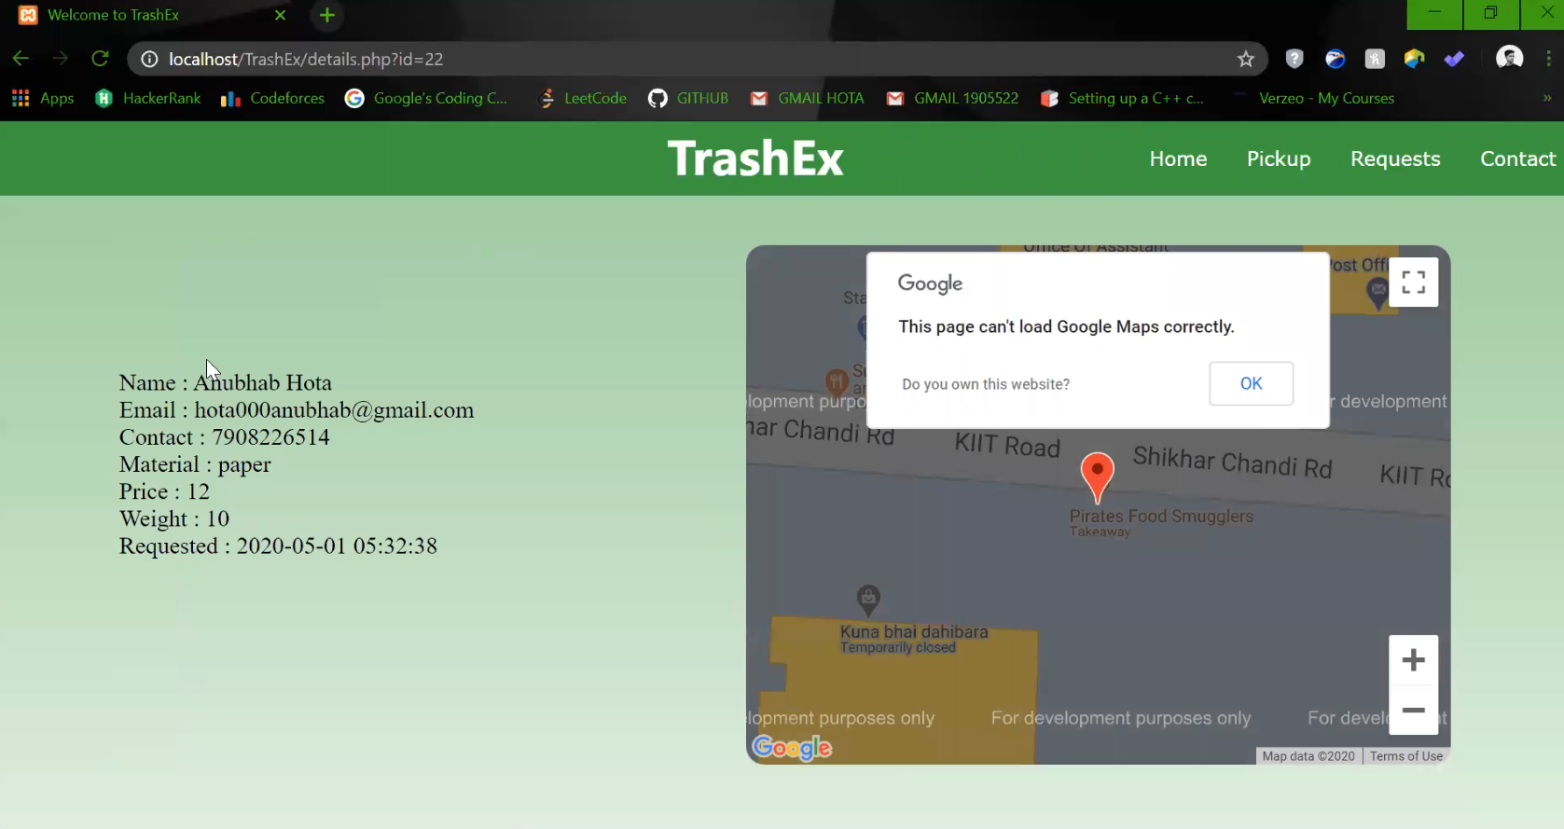
DETAILS PAGE
The Details for the pickup request and be viewed along with location data,amount,etc. with accurate timestamp of the pickup request placing.

Slide 12
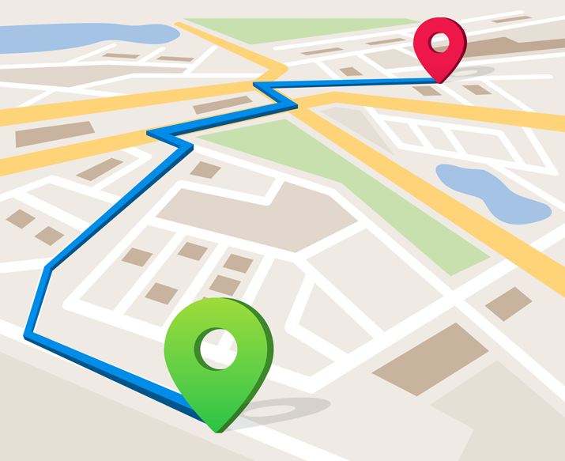
WHAT TO DO WITH THIS DATA
1. The Municipalities have limited workers to deploy. The Data can be used to generate optimized routes for collection of waste and distributing work among workers by weighting the paths using Google Directions and Distance Matrix API .
2. Non Governmental Agencies looking for recycling stuff can be allowed to check the waste requests by providing them a separate login.
3.Using PHP mailer or similar functions a auto generated mail or SMS could be sent to user that a request for pickup of the recyclable waste is accepted.
4.The Domestic Waste Pickup can be autogenerated with a function , not bothering the user much and helping municiplaties keep track of the waste.

Slide 13

FRAMEWORKS USED
1. HTML , CSS & JavaScript for the design of Frontend UI.
2. JavaScript for automating functions and use of Different APIs like Google Maps ,etc and parts of the backend.
3. PHP served as the server side language communicating with the database.
4. MySQL as our server database.
5. AJAX for processing requests from the JavaScript APIs to the PHP files.
6. XAMPP with APACHE Server and MySQL in MariaDB for the developement and debug purpose on localhost.

Slide 14

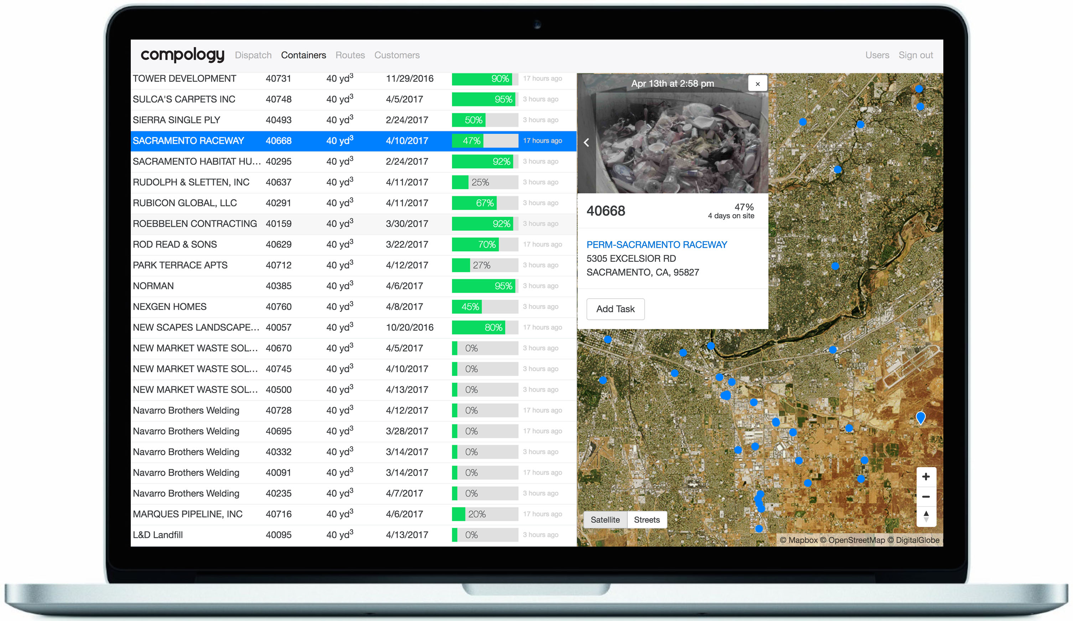
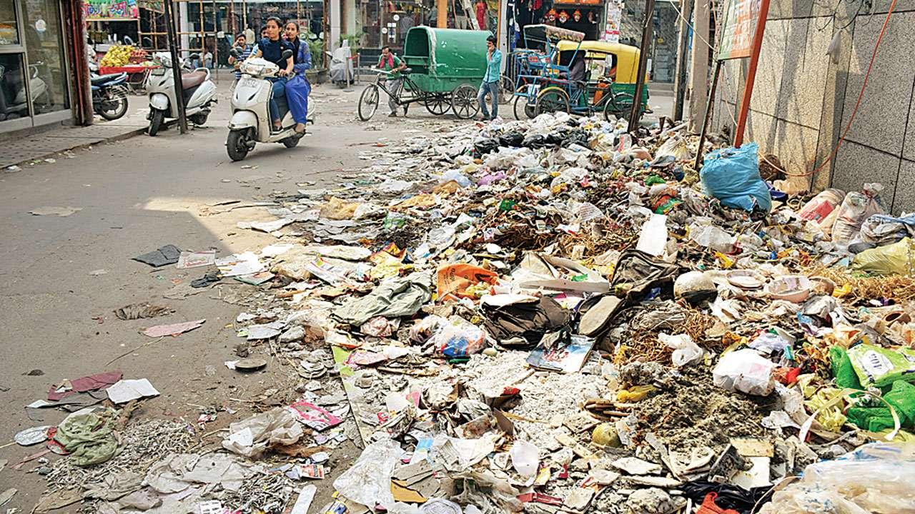
FUTURE IMPLEMENTATIONS
A view of garbage like this in the open is a common site due to lack of management and cleanliness ethics.
Although our project tries to tackle this in its own way , a help could be borrowed from the compology's API which available for use of other firms to use image processing to identify gathering of garbage at public locations like railway stations and bus stops and can be modified to our needs to auto-generate a warning for cleaning up waste at our webportal for the responsible municipality where the garbage is gathering.
This would lead to a better environment and prompt actions.

Slide 15
TrashEx
Client Side
(User)
Backend Data Process
Javascript
APIs
Database
PHP Server
MY SQL
ARCHITECTURE
DIAGRAM
Frontend UI DATA INPUT
(HTML,CSS,JS)
DATA MODIFIED USING APIs.
DATA UPLOADED TO SERVER DATABASE.
(PHP , MY SQL)
DATA RENDERED USING APIs to OPTIMIZE ROUTES and COLLECTIONS
DATA ACCESSED BY MUNICIPALITIES AND RECYCLING AGENCIES.
DATA ACCESSED BY MUNICIPALITIES AND RECYCLING AGENCIES.
PICKUP REQUEST ACCEPTED AND INITIALIAZED.
CONFIRMATION TO USER

Slide 16



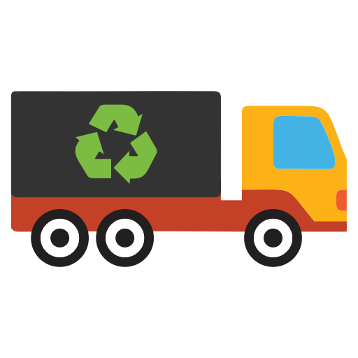
BUSINESS MODEL
Our Website would start collecting revenue from the web traffic itself.
A small percentage of the revenue collected from the requests on this page by recycling agencies can also be charged.
For each sell of junk we could charge 0.8 - 1.2 % of the collection.
A initial cost will be charged from the municipalities and recycling agencies alike , that want to activate this facility in their area or locality .
Our project is targeted towards both the citizens and the municipalities and other concerned waste management agencies.

Slide 17
Feasibility
1. India is a country of 1.35 billion people and according to census 34% people reside in urban areas contributing to large amounts of solid waste daily. This makes it quite difficult for responsible authorities to manage it effeciently.
2. Although IOT solutions have been promising to tackle waste , but it's not possible to implement them on such a large scale and people's mindset just won't want to accept a change.”Why should I implement it ? Waste is being collected like this just fine .”
3. But with our portal that provide easy steps to sell out useful recyclable junk , people would be more cautious about mixing up waste,cause who doesn't want some easy money.This would encourage waste segregation at the source itself.
4. The facility would also provide a lot of employment to people like rag-pickers and scrap-buyers who would serve as the delivery and pickup for the system with adequate amount of requests.

Slide 18
THANK YOU ☺
REUSE THE PAST , RECYCLE THE PRESENT , TO REDUCE POLLUTION IN THE FUTURE .

